Slide 1
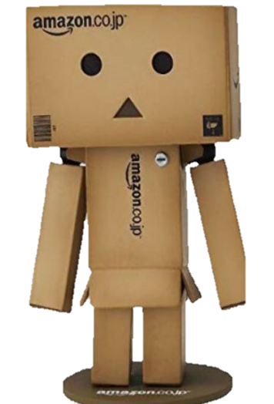
How Positive or Negative is that Review?

Slide 2

Purpose
To understand the sentiment expressed within Amazon product reviews
Key questions:
Is negative sentiment expressed within positive reviews >4 stars?
Does the overall sentiment skew positive as visualized in the overall review dataset?
Are vine reviews more favorable in sentiment?
Notes:
Jarrett

Slide 3

Business Objectives
Analyze a data set of over 20,000 Amazon reviews of personal care items spanning 2017-2019
Utilize two Python libraries to understand the sentiment expressed in individual reviews
Answer key questions related to the data set
Develop an app that will render the reviews and sentiment scores as well as score new reviews
Investigate the data set for other interesting insights
Notes:
Jarrett

Slide 4

Data Munging Techniques
DATA FETCHING
Scraped data provided after company approval
Scraped product images from Amazon.com
Imported data into an AWS Postgres database for querying
DATA MANIPULATION
Removed special characters and performed general cleaning
Added category to further group data set
Performed modeling within Jupyter notebook and provided output to the database
DATA PRESENTATION
Delivered reviews, images and basic metrics through the use of the flask app onto a webpage
Utilized bootstrap and CSS to display and organize the visualizations on the page
Utilized Tableau and a CSV file output from the database to further inspect the data
Notes:
Ken

Slide 5


Models Used

Slide 6
Lexicon, rule-based sentiment analysis tool
Attuned for sentiment expressed within social media
Takes into account capitalization and punctuation
The list words used in Vader are labeled based on the semantic orientation as POSITIVE or NEGATIVE
Vader not only tells us if a statement is positive or negative but HOW positive or negative
Provides a COMPOUND SCORE:
Vader
Sum of all lexicon ratings expressed as -1 (extreme negative) to +1 (extreme positive)
Positive sentiment = CS >=.05
Neutral sentiment = CS BETWEEN -.05 AND +.05
Negative sentiment = CS <= -.05
Notes:
Renee
A lexicon is a dictionary or the vocabulary of a language. An example is yourdictionary.com. Another example is a set of medical terms.
Semantic orientation – an opinion on a feature f states whether the opinion is positive, negative or neutral.

Slide 7
Robust python library with many NLP features such as tokenization, speech tagging, n-grams, noun-phrase extraction and sentiment analysis
Allows for text classification with pre-labeled data
Takes in processed text with punctuation and capital letters removed
Performs sentiment analysis that is described through two metrics: Polarity and Subjectivity
TextBlob
Polarity is expressed as a float between -1 and +1. +1 is a very positive statement while -1 is very negative.
Subjectivity is the amount of personal opinion [0-1], emotion or judgement expressed within the text.
Subjective statements contain more emotion while objective statements contain more facts. Subjectivity closer to 1 indicates a high amount of emotion in the text.
Notes:
Heather

Slide 8
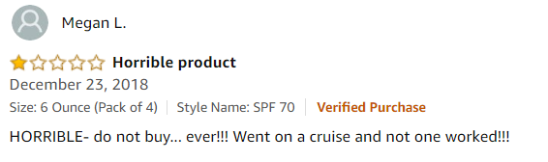
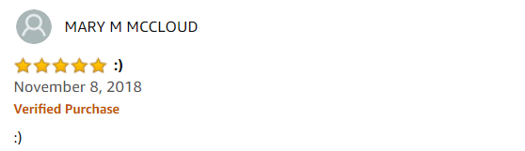
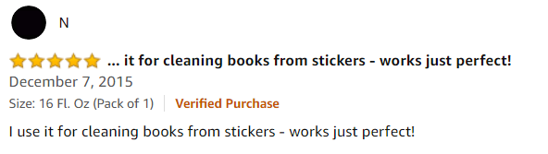
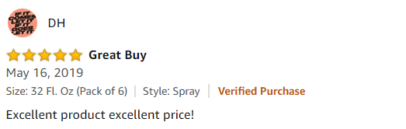
Model Output
Notes:
Heather

Slide 9

Model Performance
TextBlob
Vader
Notes:
Heather

Slide 10
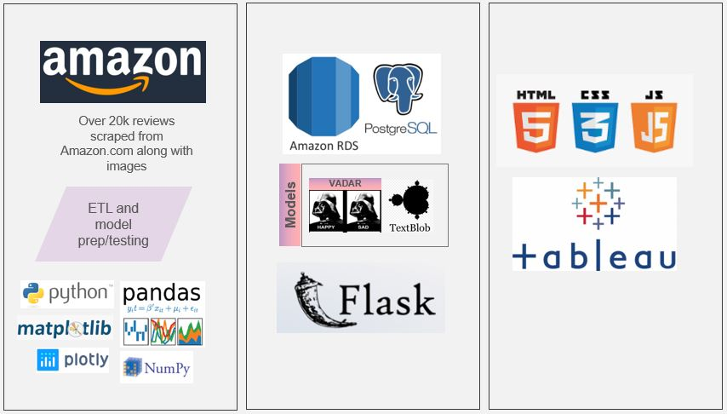
Architecture
Notes:
Ken

Slide 11
Live Demo
Notes:
Renee/Ken

Slide 12
Findings
4 and 5 star reviews generally utilize positive words
Limited negative sentiment in reviews > 4 stars
Vader and TextBlob analyzed sentiment in a comparable manner but Vader does take into account emoticons, capitalization and punctuation
Extreme polarization was discovered in the Sun Care category with sun lotions having very positive sentiment and sun sprays having very negative sentiment
Overall, vine reviews had a statistically significant higher average compound score compared to non-vine reviews
Overall, non-vine reviews had a statistically significant higher average polarity score compared to vine reviews
Notes:
Jarrett

Slide 13
Pain Points/Next Steps
Perform more intensive pre-processing
Generate own library of positive and negative words
Try out n-grams to improve model output
Investigate other NLP libraries
Create our own model based upon the star ratings
Add automatic notification to the app in the event of a negative review
Perform more extensive statistical analysis
Notes:
Heather

